Slide 1

Introduction to QGIS:
Understanding and Presenting Spatial Data
Mon 7th Nov 2016, 9:30am – 4pm
Dr Nick Bearman
@nickbearmanuk
Department of Geography and Planning

Slide 2
Introduction to QGIS:
Understanding and Presenting Spatial Data
Tues 1st Nov 2016, 10am – 4:30pm
Dr Nick Bearman
@nickbearmanuk
Department of Geography and Planning

Slide 3
Welcome
Introductions
Who are you?
What GIS have you used before?
What do you want from the course?

Slide 4
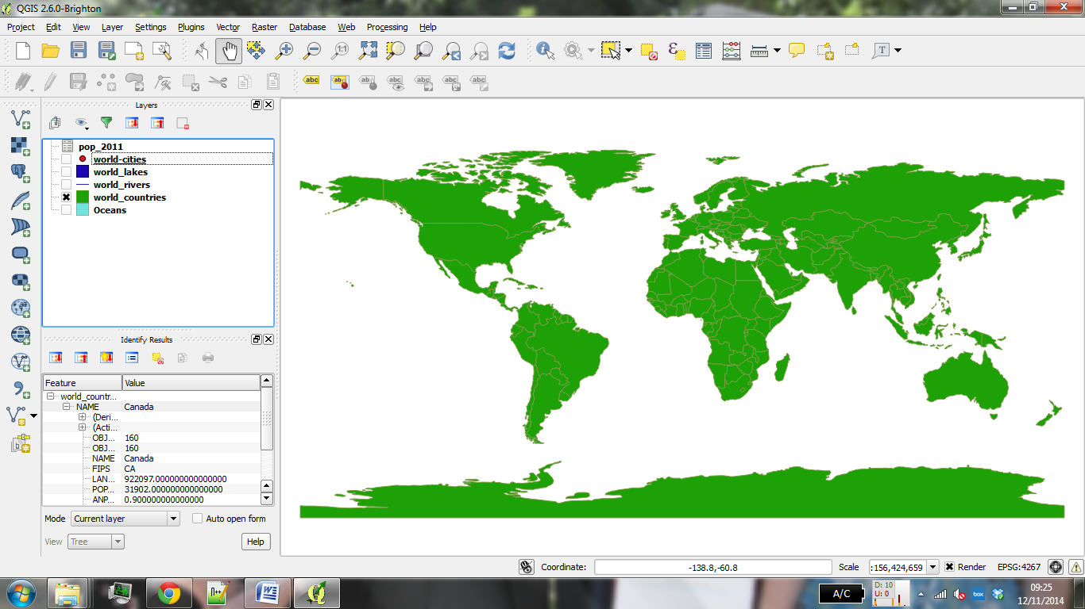
What will you get from the course?
Background on QGIS and spatial data
Load spatial data
Basic spatial analysis

Slide 5
What will you get from the course?
Appropriate methods of visualizing data
Creating a publication quality map
Using your own data
Presentations etc. are available online

Slide 6
Outline of the day
10:15am – 10:30am – What is GIS?
10:30am - 11:15am – Prac. 1 Intro to QGIS
11:15am – 11:45am – Classification
11:45am - 12:30pm – Prac. 1 Intro to QGIS
12:30pm - 1:30pm – Lunch
1:30pm - 1:45pm – Recap and Map Design
1:45pm - 3:00pm – Practical 2 Tiger Map
3:00pm - 3:15pm – Coffee
3:15pm - 4pm/4:30pm – Practical 2 BYOD
Notes:
Practical 2 – Bring Your Own Data

Slide 7
Outline of the day
9:45am - 10:15am – What is GIS?
10:15am - 11:00am – Prac. 1 Intro to QGIS
11:00am - 11:30am – Classification
11:45am - 12:30pm – Prac. 1 Intro to QGIS
12:30pm - 1:30pm – Lunch
1:30pm - 1:45pm – Recap and Map Design
1:45pm - 3:00pm – Practical 2 Tiger Map
3:00pm - 3:15pm – Coffee
3:15pm - 4pm/4:30pm – Practical 2 BYOD
Notes:
Practical 2 – Bring Your Own Data

Slide 8
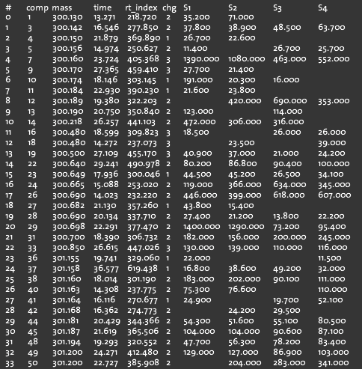
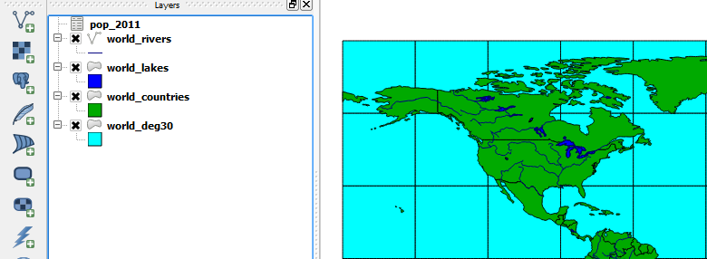
What is GIS?
Turning (spatial) data into information
Using this information to answer questions
How have housing conditions changed in the past ten years?
http://www.flickr.com/photos/dsleeter_2000/3097476532 & ESRI Course “Teaching with GIS”

Slide 9
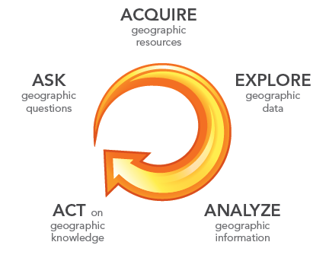
What is GIS?
Turning (spatial) data into information
Using this information to answer questions
How have housing conditions changed in the past ten years?
http://www.flickr.com/photos/dsleeter_2000/3097476532 & ESRI Course “Teaching with GIS”

Slide 10
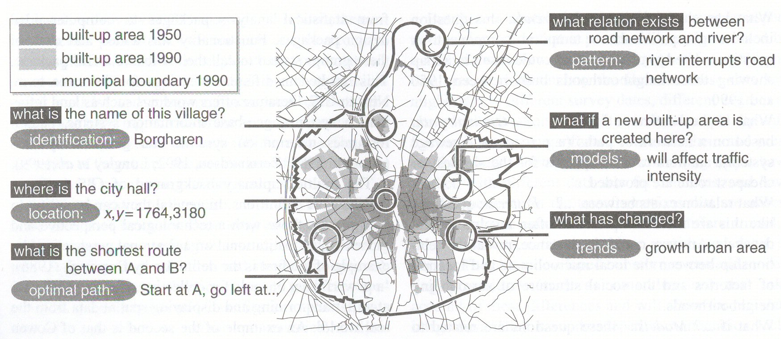
Types of questions a GIS can answer
Source: Kraak & Ormeling (2003) p.7.
Notes:
We can use a GIS for an almost infinite range of purposes, including…
-Location-based queries (e.g. where is the community centre?)
Relationship-based queries (e.g. where is the nearest Well or bore hole?)
Network analysis (e.g. what is the shortest route between A and B?)
Trend analysis (e.g. how has land use changed between time A and time B?)
3D visualisation (e.g. displaying 3d flood models)
This course will give you experience in using all three levels of using geographic information systems.

Slide 11
GIS – Geographic Information Systems
Almost all human activities and decisions involve an important geographic component
the ‘where?’
Working with geographic information involves unique, complex and difficult choices
Why we need specialized software
organize and store
access and retrieve
manipulate and synthesize
apply to the solution of problems

Slide 12
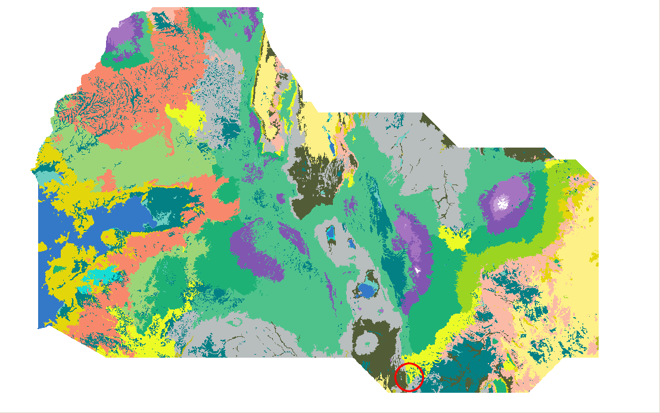
Kenya Vegetation Figure 1 - http://pvanb.wordpress.com/2010/06/10/clickfu-in-qgis/

Slide 13
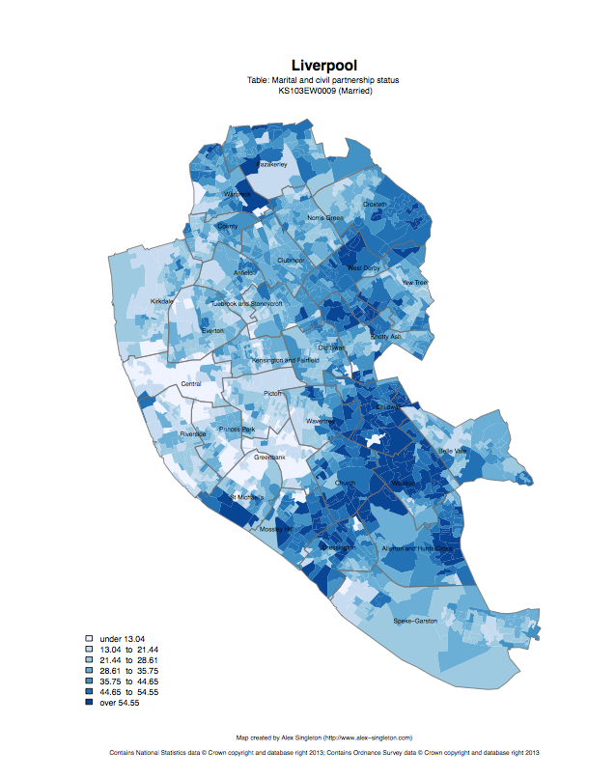
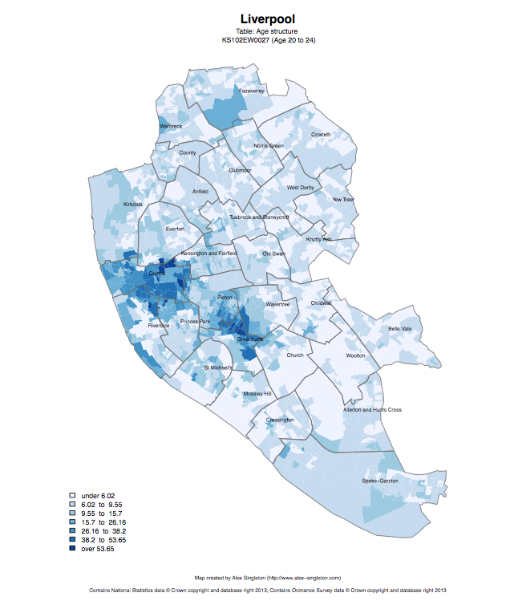
Census 2011
Married
Age structure – 20 to 24
http://www.alex-singleton.com/r/2014/02/05/2011-census-open-atlas-project-version-two/

Slide 14
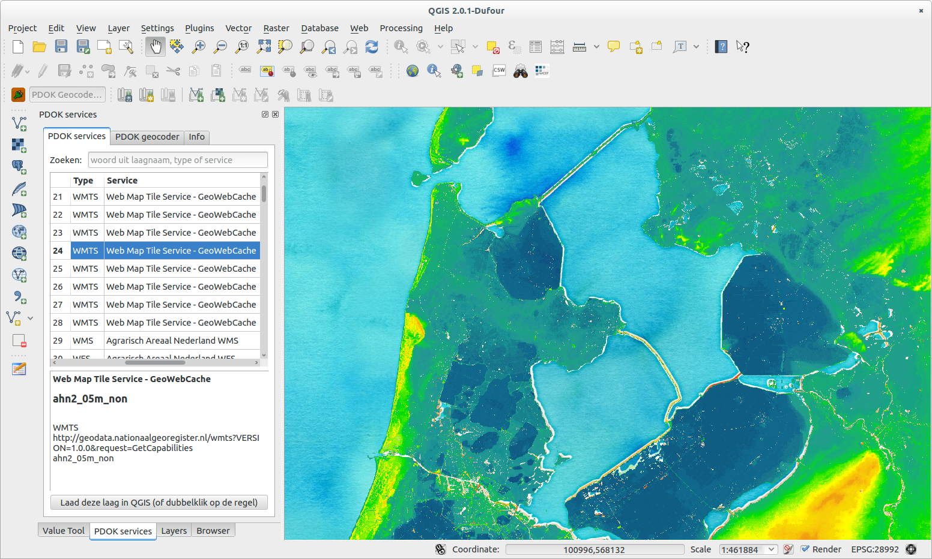
Netherlands Topography - https://publicwiki.deltares.nl/display/OET/Dataset+documentation+AHN2

Slide 15
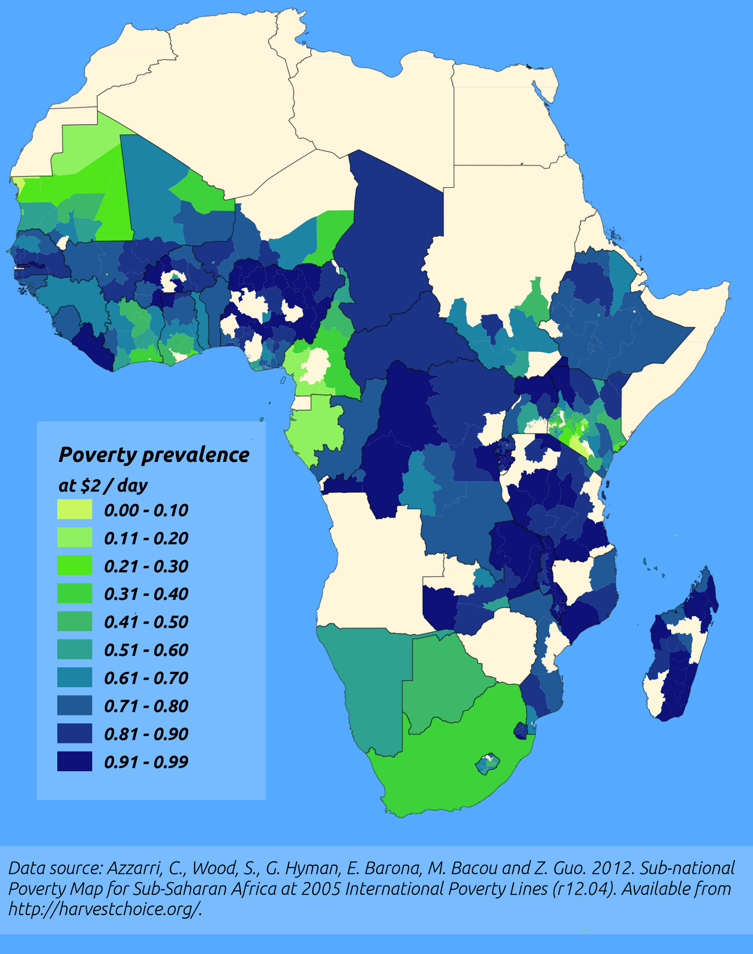
http://pvanb.wordpress.com/2012/05/09/poverty-maps-on-harvestchoice/

Slide 16
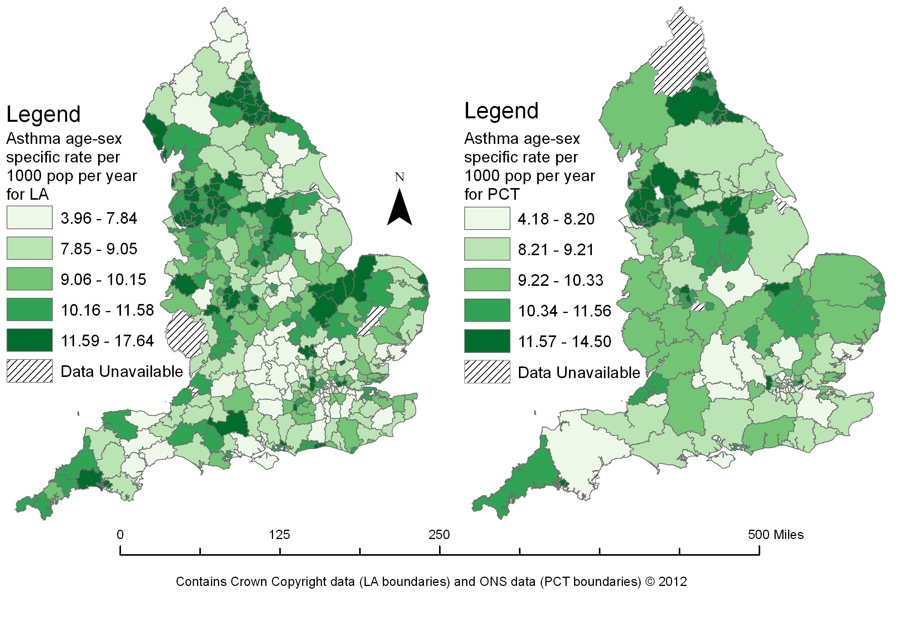

Slide 17





CDRC
ESRC
Outreach – Stakeholder Users
Engagement – PhD / MSc / Training
Data and Services
Open, Safeguarded, Controlled

Slide 18




Other GIS software?
QGIS has many features, but fewer than ArcGIS
QGIS is free (as is R)
QGIS is increasingly popular in not for profit sector, academic and commercial
All can be useful

Slide 19
Start up computers
Press power button

Slide 20
Projections and Coordinate Systems
Who has heard of these?
Why are they important?

Slide 21
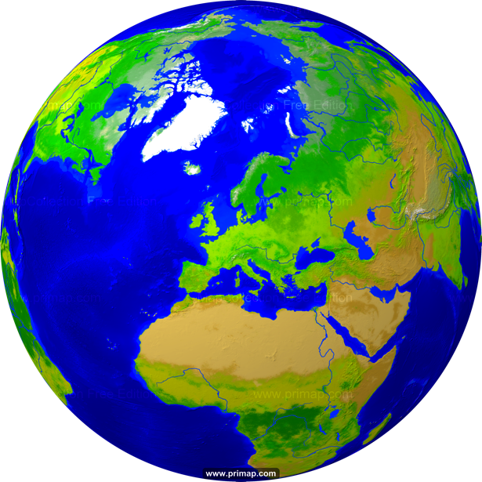
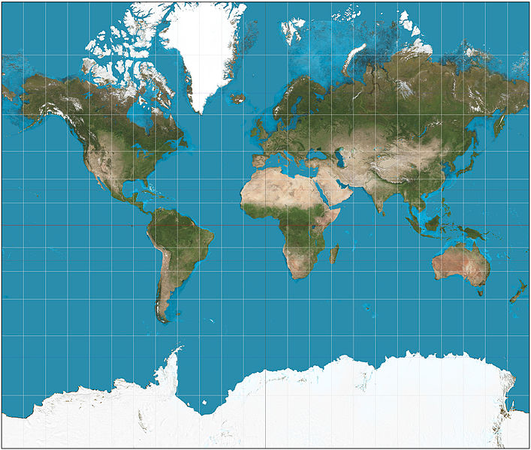
Projections
Projection – going from a sphere to a flat surface
http://www.primap.com/wsen/Maps/MapCollection/WorldMaps/Globe-(Europe-centered)-Vegetation-4000x4000.html

Slide 22

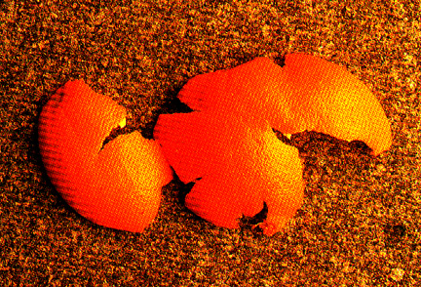
Projections
Projection – going from a sphere to a flat surface
http://krygier.owu.edu/krygier_html/geog_353/geog_353_lo/geog_353_lo05.html
http://www.hdwallpapersos.com/orange-fruit-hd-wallpapers.html

Slide 23
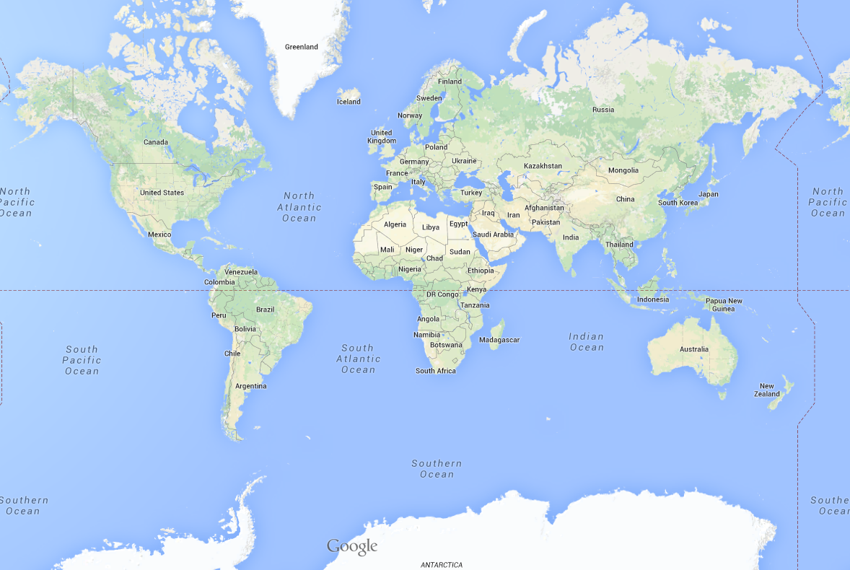
This file is licensed under the Creative Commons Attribution-Share Alike 3.0 Unported license. http://en.wikipedia.org/wiki/File:Mercator_projection_SW.jpg
Mercator projection

Slide 24
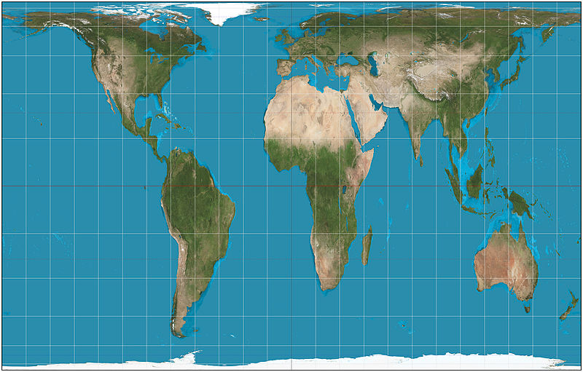
This file is licensed under the Creative Commons Attribution-Share Alike 3.0 Unported license. http://en.wikipedia.org/wiki/File:Mercator_projection_SW.jpg
Mercator projection
Gall-Peters projection
This file is licensed under the Creative Commons Attribution-Share Alike 3.0 Unported license. http://en.wikipedia.org/wiki/File:Gall%E2%80%93Peters_projection_SW.jpg

Slide 25
Africa: 30 million sq km
Greenland: 2 million sq km

Slide 26
Projections etc.
Reprojection Can’t maintain area and angles
Peters: area
Mercator: angles

Slide 27
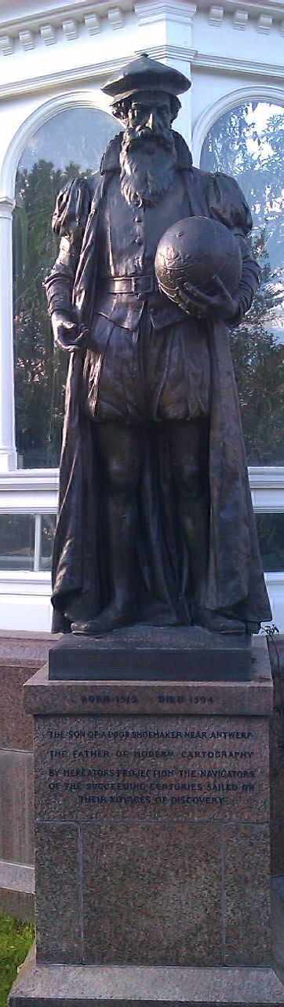
Mercator
The son of a poor shoemaker near Antwerp, Belgium
The Father of Modern Cartography
By Mercator’s Projection the navigators of the succeeding centuries sailed on their voyages of discovery
1569

Slide 28
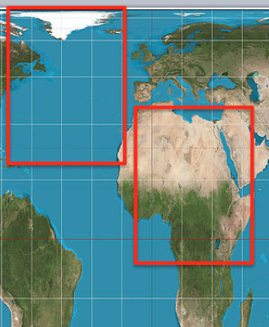
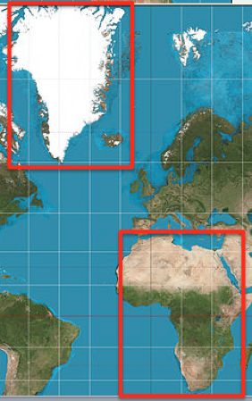
Why are Projections important?
The map(s) may not be as they appear
Data may appear in the wrong place

Slide 29
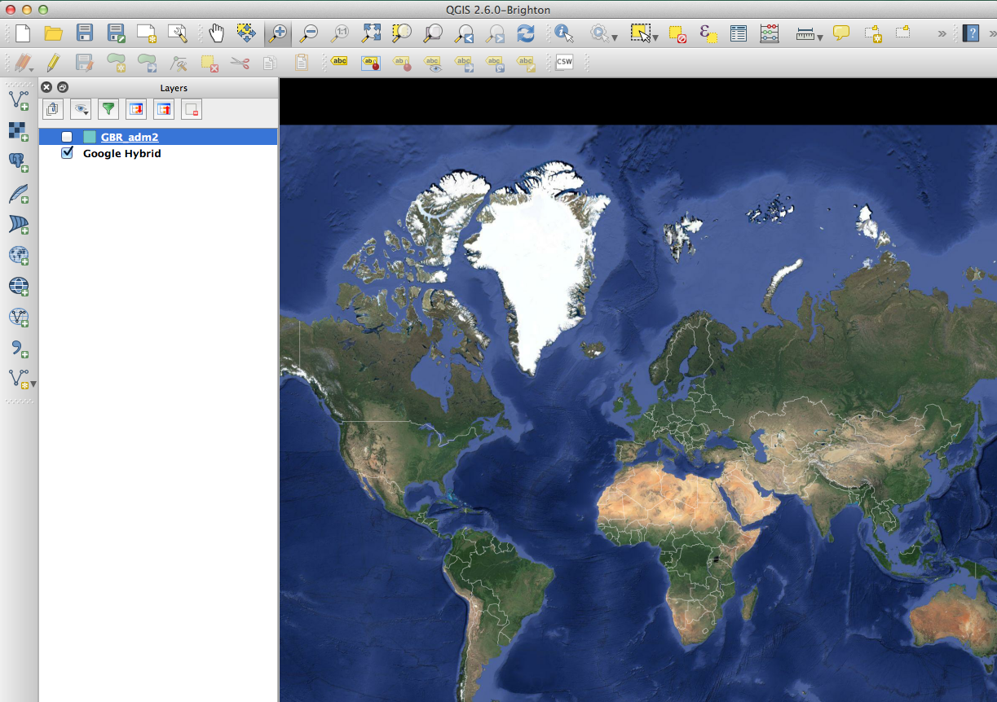

Slide 30
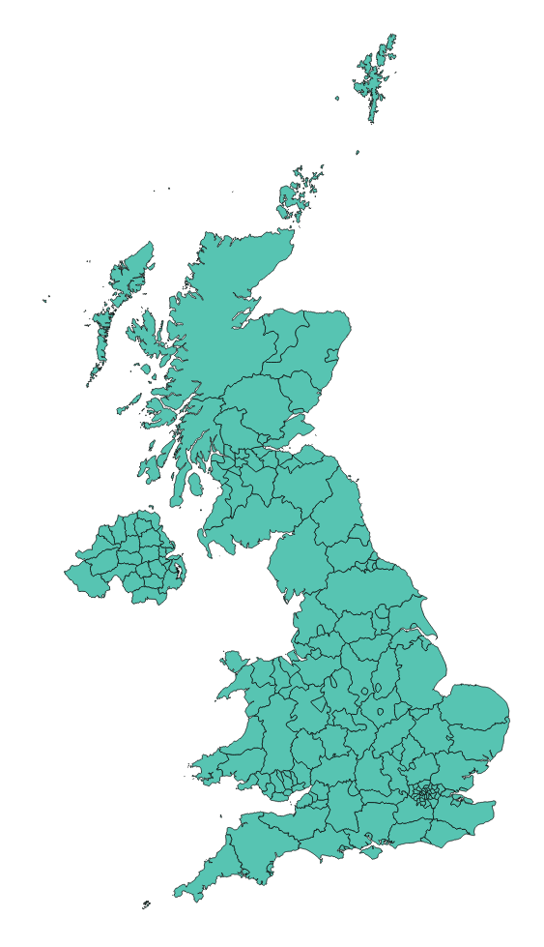

Slide 31
Why are Projections important?
The map(s) may not be as they appear
Data may appear in the wrong place
Coordinate Systems

Slide 32
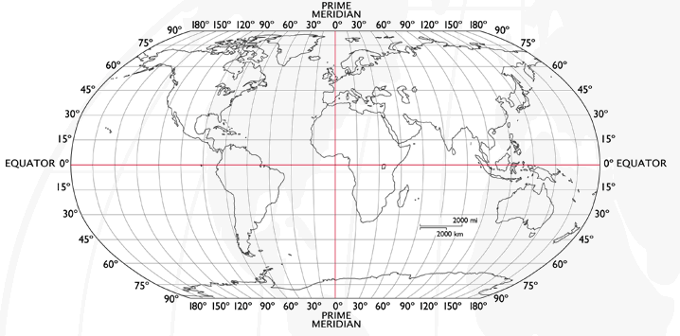
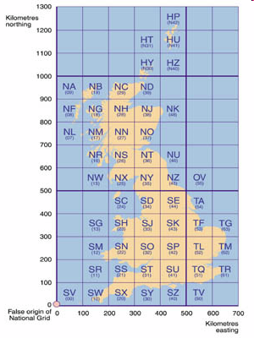
Coordinate Systems
Latitude and Longitude (WGS 1984) EPSG = 4326
52°N 37’ 30.32’’ (52.6250) 1°E 14’ 2.05’’ (1.2339)
British National Grid (Eastings & Northings)
Easting: 619301 Northing: 307416 EPSG = 27700
Why is it important?
Some data uses uses WGS84
LSOA use BNG (Eastings/Northings)
Need to convert between the two
Notes:
-Coordinate Systems are derived from projections and are used to give coordinates (numbers) to locations on the Earth’s surface
-Best if your data is all in the same coordinate system (otherwise the coordinates might be slightly different for the same location), but ArcMap can convert between them
-Most common:
-Lat/Long (also WGS 1984) used by most GPS
-BNG (British National Grid) very common in UK data – Ordnance Survey format.
-Most important – are all your data in the same coordinate system?
-ArcMap can convert, but often if your data appears in the wrong place, it is because there is something wrong with the coordinate system.
http://www.worldatlas.com/webimage/testmaps/latslongs.htm
http://www.ordnancesurvey.co.uk/oswebsite/gps/information/coordinatesystemsinfo/guidetonationalgrid/page13.html
http://www.ordnancesurvey.co.uk/oswebsite/gps/information/coordinatesystemsinfo/guidetonationalgrid/page8.html

Slide 33
Joining
Area ID
1
2
3
4
5
14
7
8
11
Area ID | Deprivation
1 | High
2 | High
3 | High
4 | Average
5 | Average
6 | Average
7 | Low
8 | Low
9 | Low
10 | High
11 | Low
12 | High
13 | High
14 | Average
15 | Average
1
2
3
14
4
7
5
8
11
Data
Polygons
Lookup

Slide 34
1
Area ID | Deprivation
1 | High
2 | High
3 | High
4 | Average
5 | Average
14 | Average
7 | Low
8 | Low
11 | Low
2
3
14
4
7
5
8
11
High Deprivation
Average Deprivation
Low Deprivation

Slide 35
QGIS follow on screen

Slide 36
Make new Folder
DL zip
Unzipping it
Open QGIS
Add world_countires
Zoom & pan

Slide 38
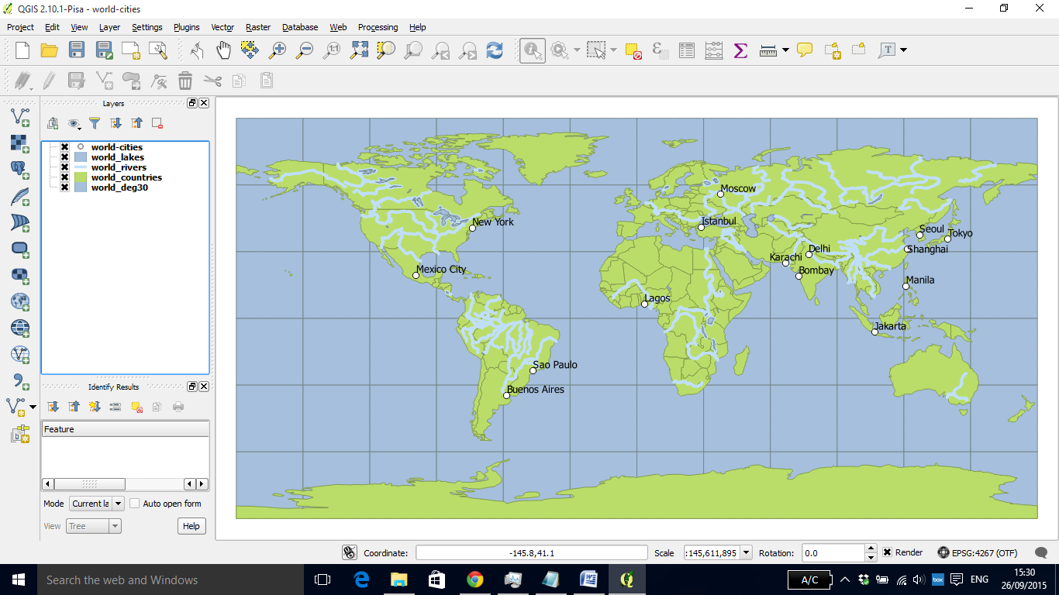

Slide 40
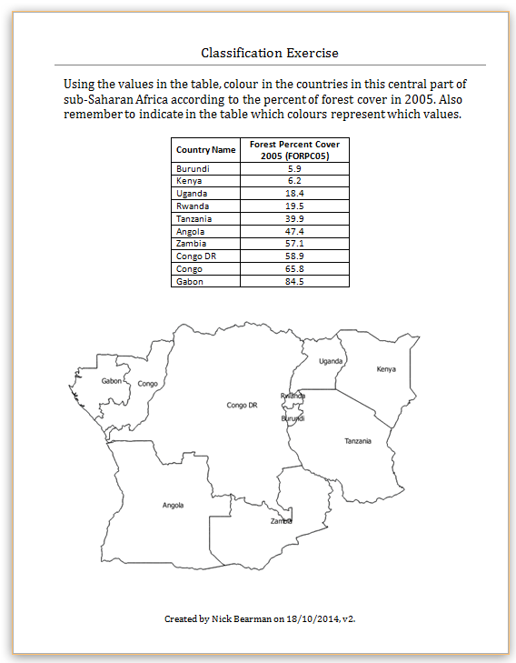
Classification
Colour in the values for Forest Cover (10 min)
Discuss your choices

Slide 41
Classification
Colour in the values for Forest Cover (10 min)
Discuss your choices
Colours
Classes

Slide 42
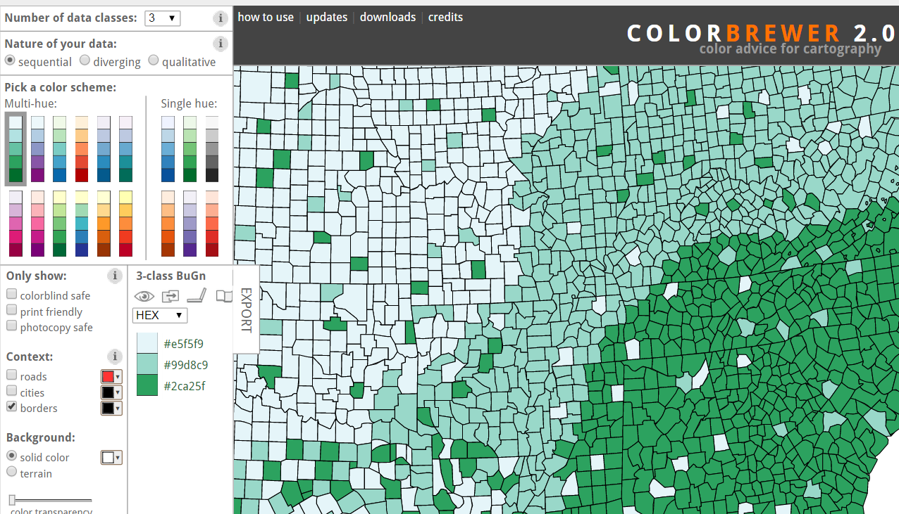
Map Design: Classification
Choropleth maps have colours
How do you choose the colours?
Why is this important?
Output
User
colorbrewer.org

Slide 43
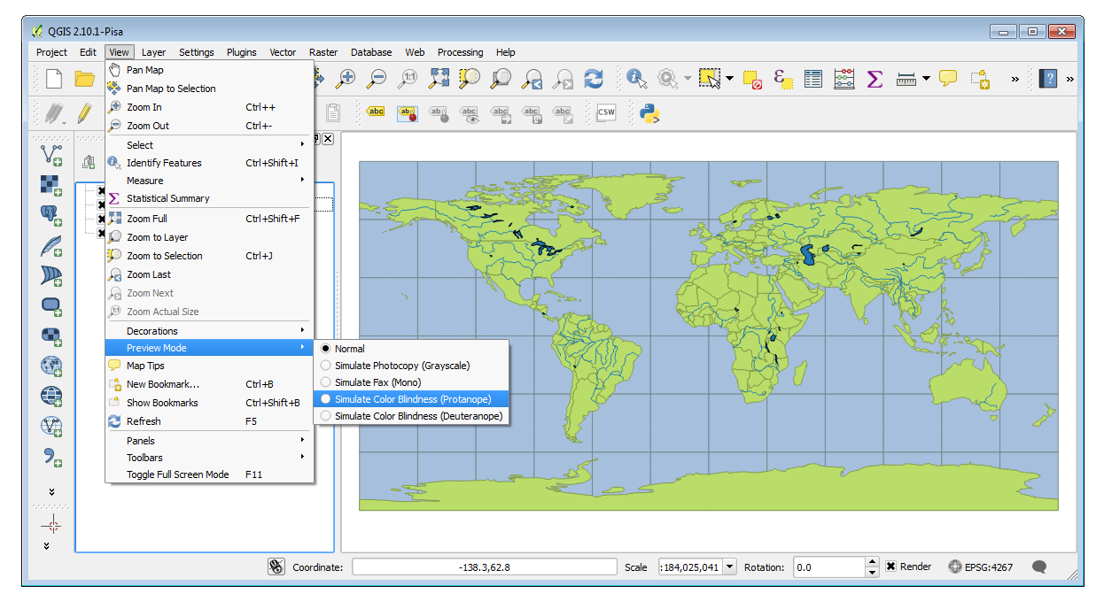
http://nyalldawson.net/2014/05/and-now-colour-preview-modes-in-qgis-map-canvas/

Slide 44
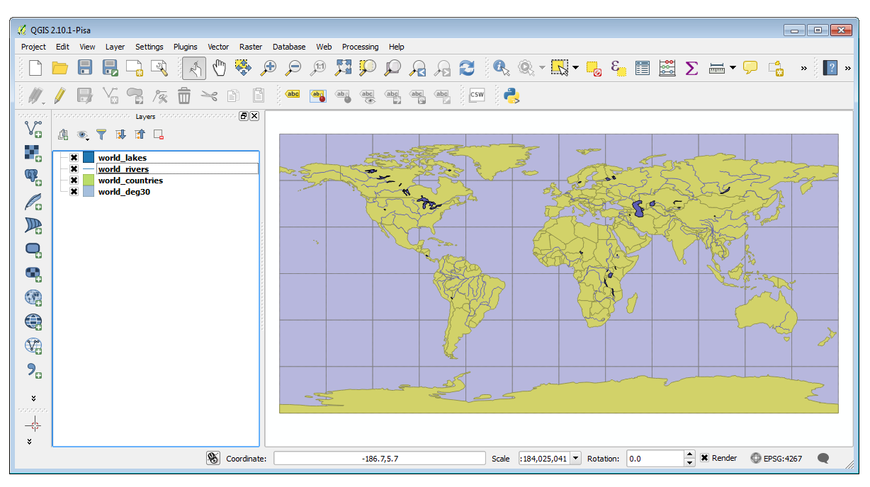
http://nyalldawson.net/2014/05/and-now-colour-preview-modes-in-qgis-map-canvas/
Notes:
Doesn’t work in OSX
See: https://hub.qgis.org/issues/10761

Slide 45
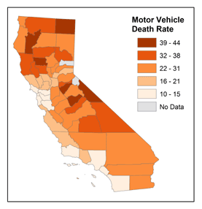
Map Design: Classification
Choropleth maps have classes
How do you choose the classes?
Why is this important?
© 2014 The Pennsylvania State University, https://www.e-education.psu.edu/geog486/l4_p7.html#classification_schemes

Slide 46
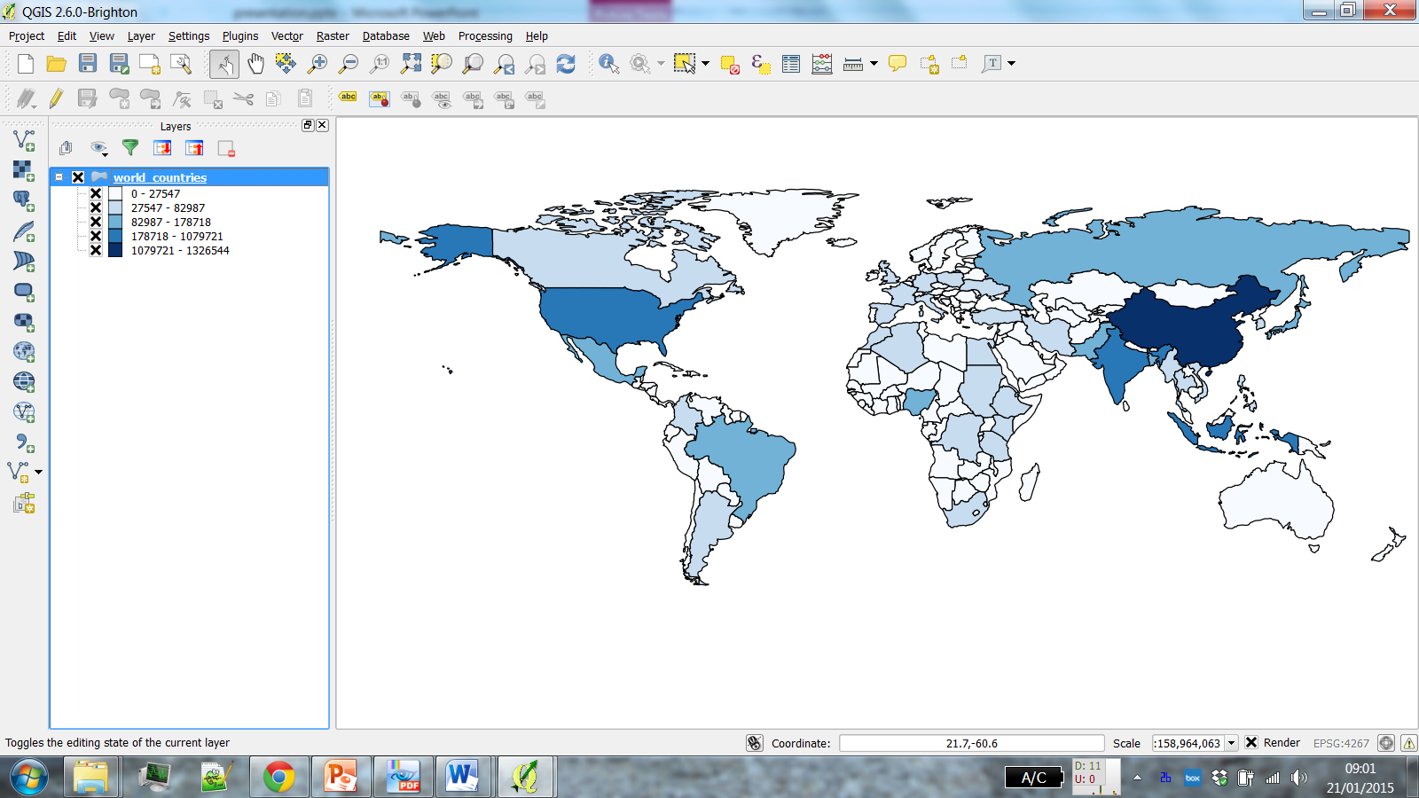
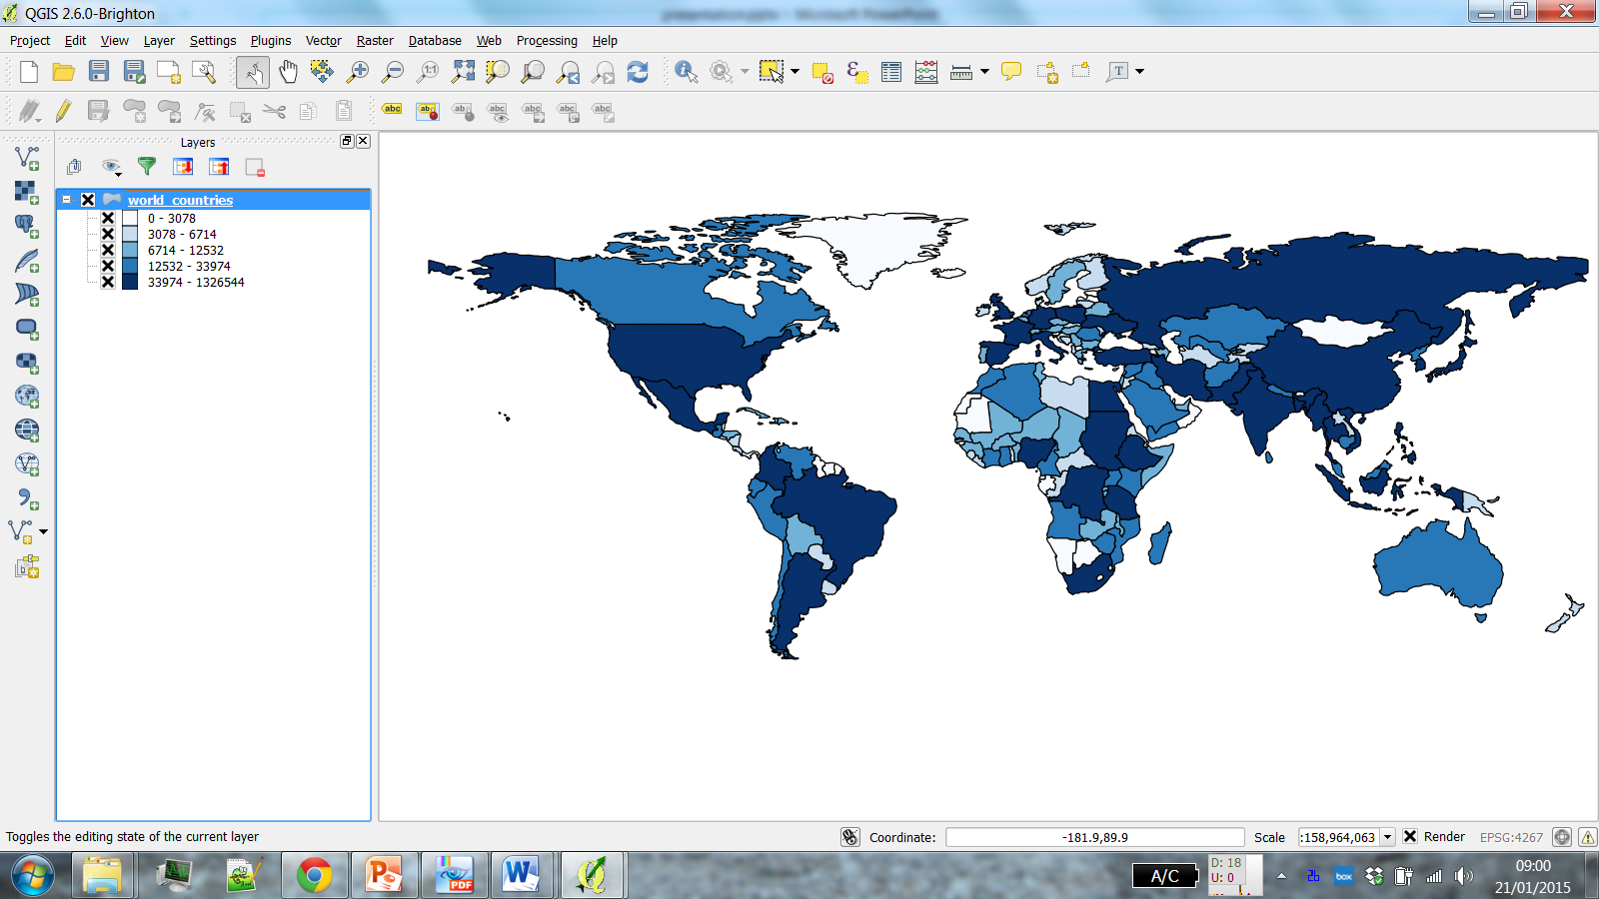
Why is it important?
POP2004
Natural Breaks
(Jenks)
Quantile
(Equal Count)

Slide 47
Why is it important?
POP2004
Natural Breaks
(Jenks)
Quantile
(Equal Count)

Slide 48
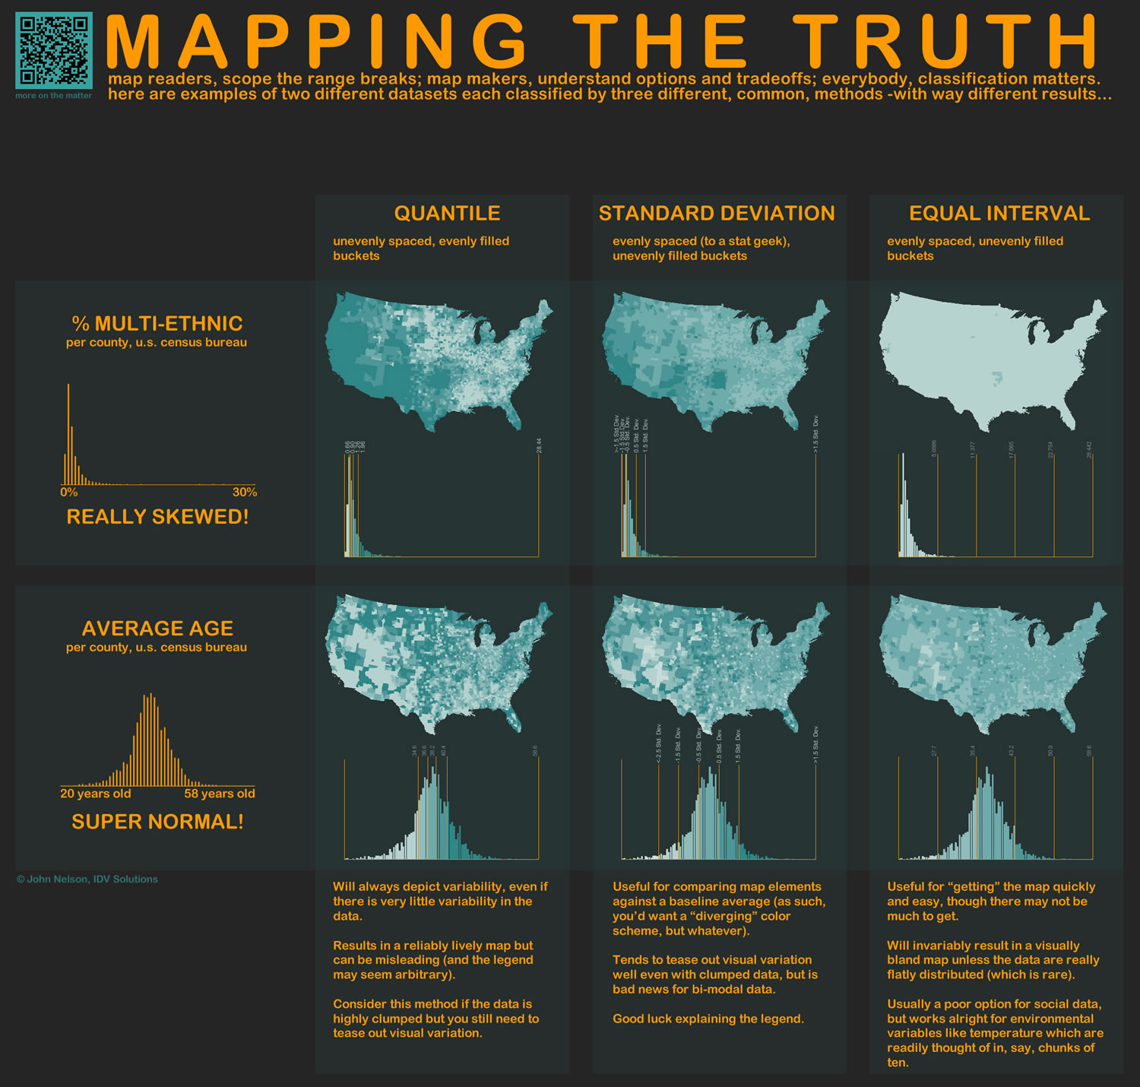
http://www.flickr.com/photos/idvsolutions/6691496421/in/photostream/

Slide 49
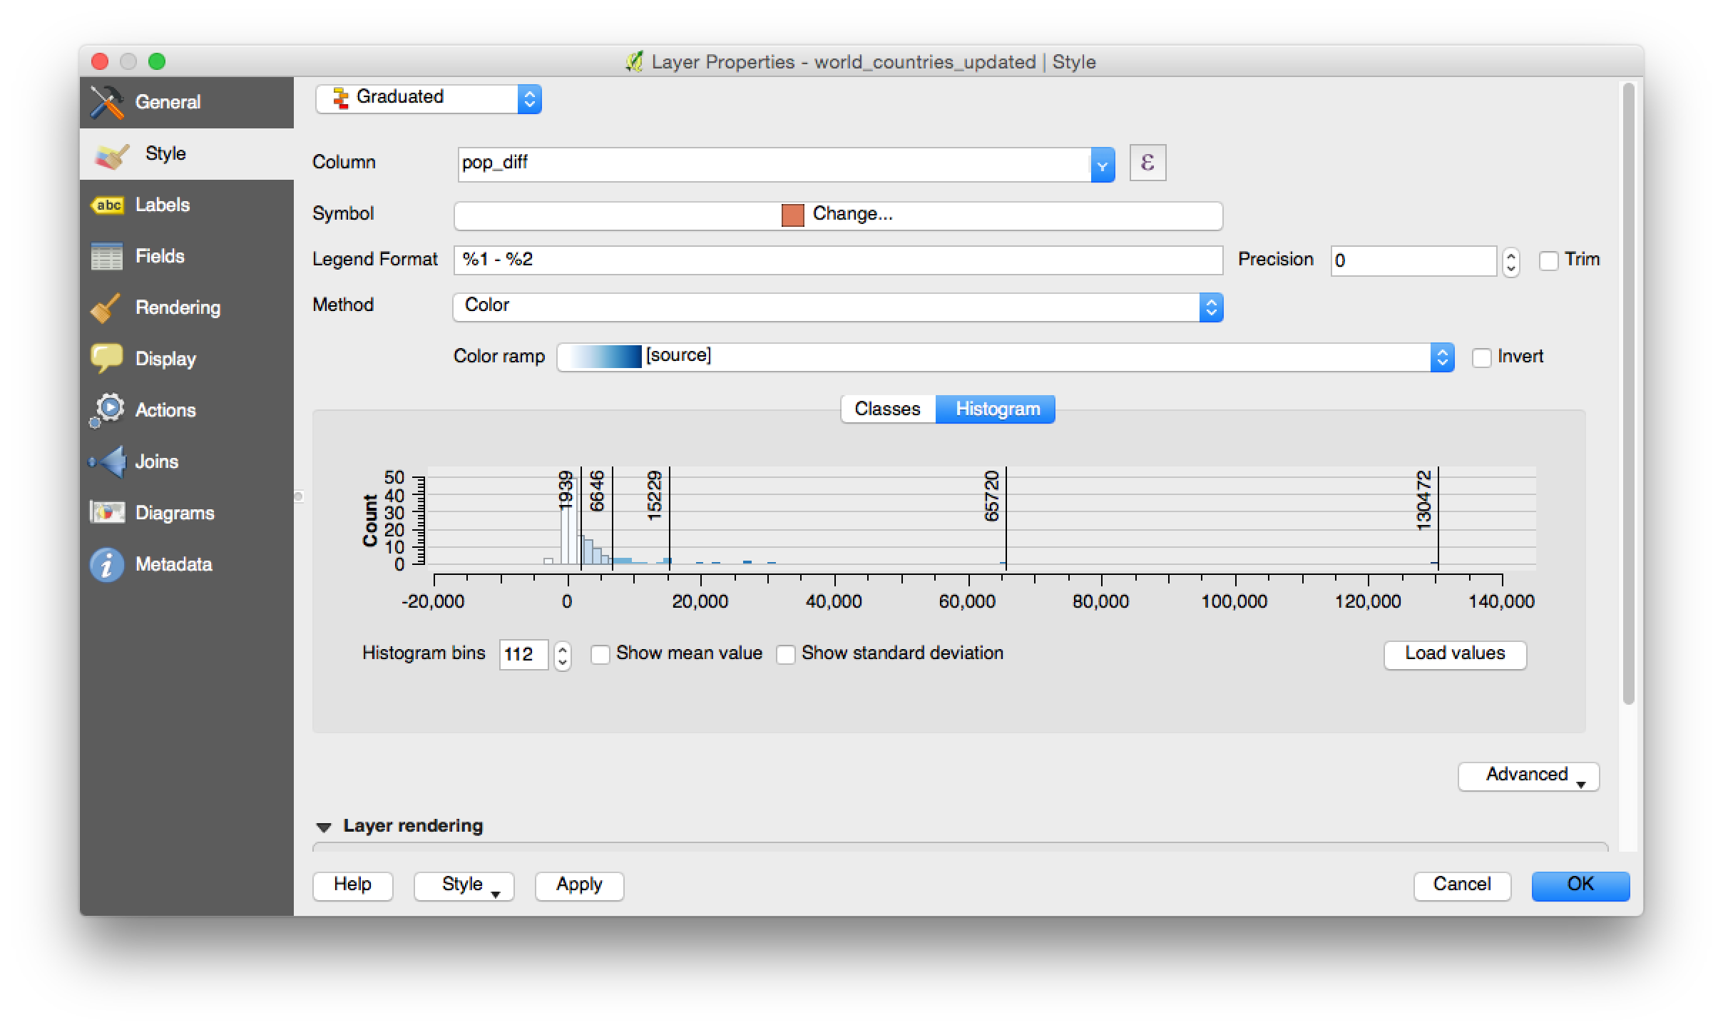
Notes:
Live demo, if possible.

Slide 50

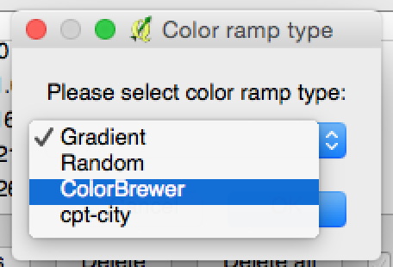
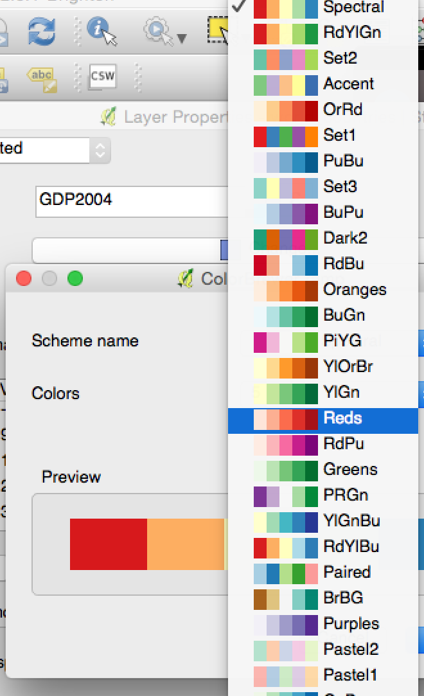
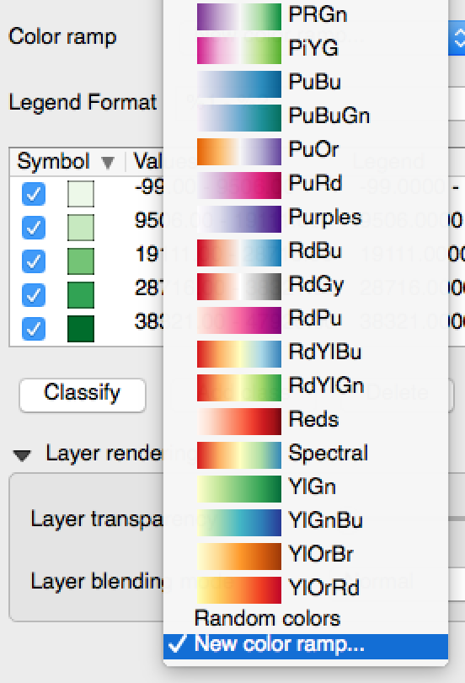
ColorBrewer in QGIS
http://anitagraser.com/2010/08/29/qgis-meets-colorbrewer/

Slide 51
NULL Values
What about missing data?
Null, 0, -9999
Country | Pop 2004 | Pop 2011 | Difference
Luxembourg | 450 | 525 | 75
Switzerland | 7382 | 8014 | 632
France | 59991 | 65653 | 5644
Korea Rep (South) | 48142 | NULL | NULL
Cyprus | 776 | 839 | 63

Slide 52
If NULL is represented using:
Country | Pop 2004 | Pop 2011 | Difference
Luxembourg | 450 | 525 | 75
Switzerland | 7,382 | 8014 | 632
France | 59,991 | 65,653 | 5,644
Korea Rep (South) | 48,142 | 0 | -48,142
Cyprus | 776 | 839 | 63
0
-9999
Country | Pop 2004 | Pop 2011 | Difference
Luxembourg | 450 | 525 | 75
Switzerland | 7,382 | 8,014 | 632
France | 59,991 | 65,653 | 5644
Korea Rep (South) | 48,142 | -9,999 | 58,141
Cyprus | 776 | 839 | 63

Slide 53
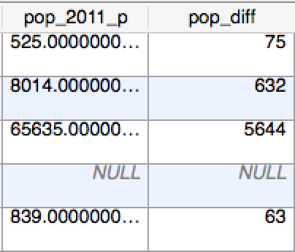

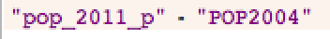
Calculating New Values
Population
Population change
Field Calculator

Slide 54
Calculating New Values
Population
Population change
Population change %
Field Calculator

Slide 55
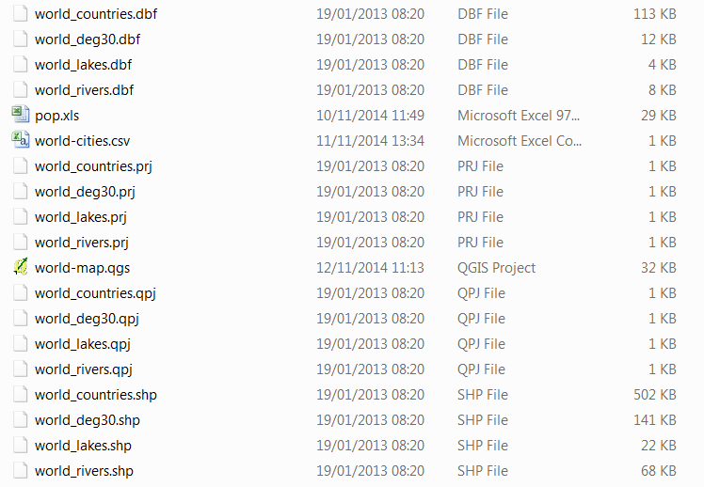
Saving Files

Slide 56
Outline of the day
10:15am – 10:30am – What is GIS?
10:30am - 11:15am – Prac. 1 Intro to QGIS
11:15am – 11:45am – Classification
11:45am - 12:30pm – Prac. 1 Intro to QGIS
12:30pm - 1:30pm – Lunch
1:30pm - 1:45pm – Recap and Map Design
1:45pm - 3:00pm – Practical 2 Tiger Map
3:00pm - 3:15pm – Coffee
3:15pm - 4pm/4:30pm – Practical 2 BYOD
Notes:
Practical 2 – Bring Your Own Data

Slide 57
Outline of the day
9:45am - 10:15am – What is GIS?
10:15am - 11:00am – Prac. 1 Intro to QGIS
11:00am - 11:30am – Classification
11:45am - 12:30pm – Prac. 1 Intro to QGIS
12:30pm - 1:30pm – Lunch
1:30pm - 1:45pm – Recap and Map Design
1:45pm - 3:00pm – Practical 2 Tiger Map
3:00pm - 3:15pm – Coffee
3:15pm - 4pm/4:30pm – Practical 2 BYOD
Notes:
Practical 2 – Bring Your Own Data

Slide 58
Continue Practical

Slide 59
Classifications

Slide 60
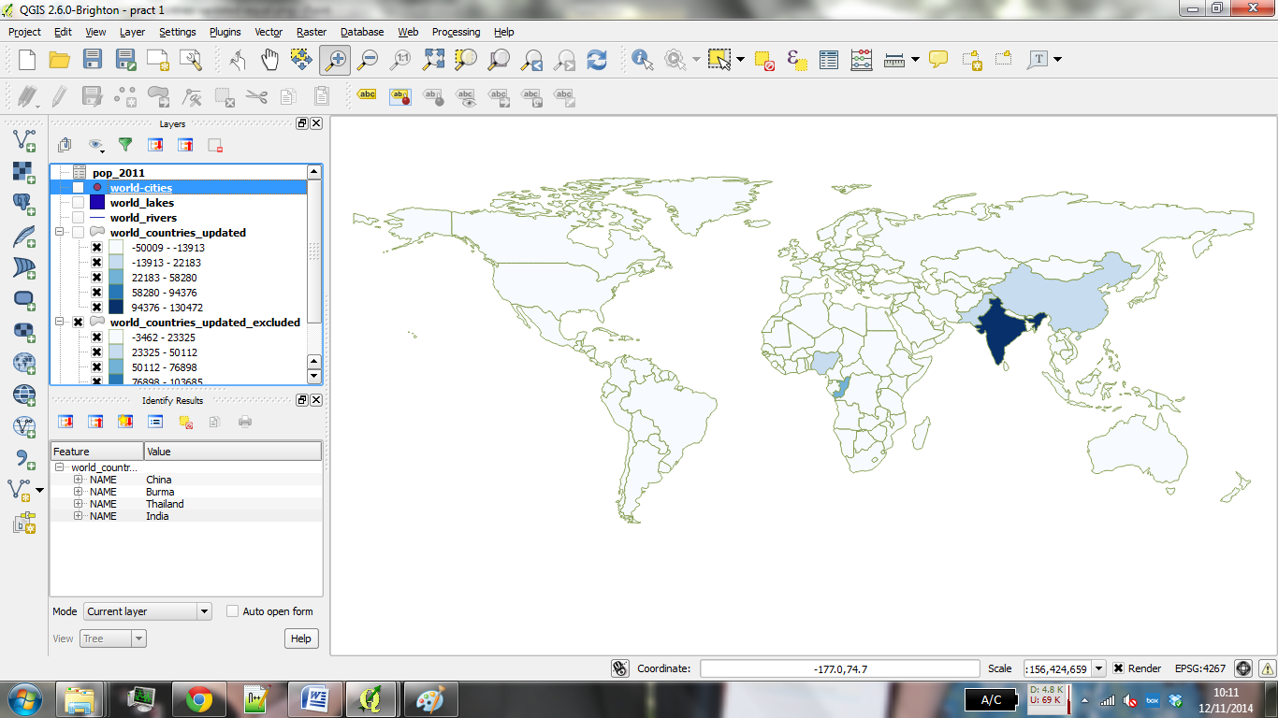
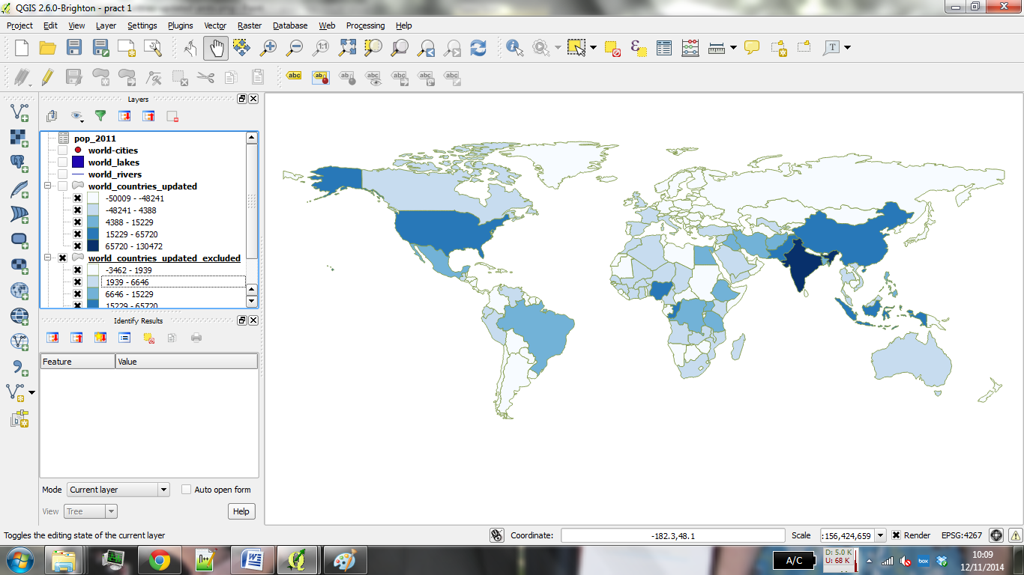
Equal Interval
Jenks

Slide 61
Lunch

Slide 62
Outline of the day
10:15am – 10:30am – What is GIS?
10:30am - 11:15am – Prac. 1 Intro to QGIS
11:15am – 11:45am – Classification
11:45am - 12:30pm – Prac. 1 Intro to QGIS
12:30pm - 1:30pm – Lunch
1:30pm - 1:45pm – Recap and Map Design
1:45pm - 3:00pm – Practical 2 Tiger Map
3:00pm - 3:15pm – Coffee
3:15pm - 4pm/4:30pm – Practical 2 BYOD
Notes:
Practical 2 – Bring Your Own Data

Slide 63
Outline of the day
9:45am - 10:15am – What is GIS?
10:15am - 11:00am – Prac. 1 Intro to QGIS
11:00am - 11:30am – Classification
11:45am - 12:30pm – Prac. 1 Intro to QGIS
12:30pm - 1:30pm – Lunch
1:30pm - 1:45pm – Recap and Map Design
1:45pm - 3:00pm – Practical 2 Tiger Map
3:00pm - 3:15pm – Coffee
3:15pm - 4pm/4:30pm – Practical 2 BYOD
Notes:
Practical 2 – Bring Your Own Data

Slide 64
Spatial Data
Country boundaries / sub-national boundaries
www.gadm.org
EuroStat
Country spatial data service
GB – Ordnance Survey
Google Search – shapefile / GIS

Slide 65
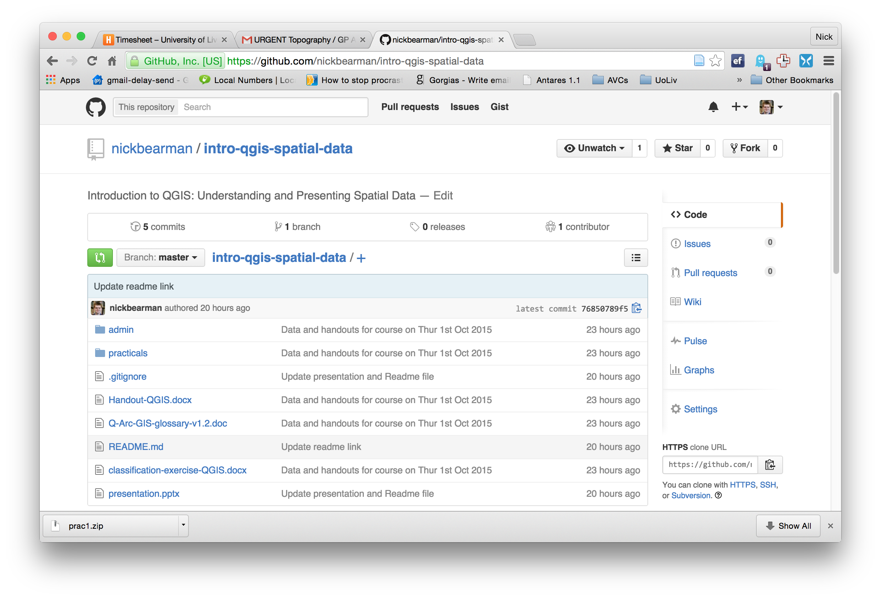

Slide 66
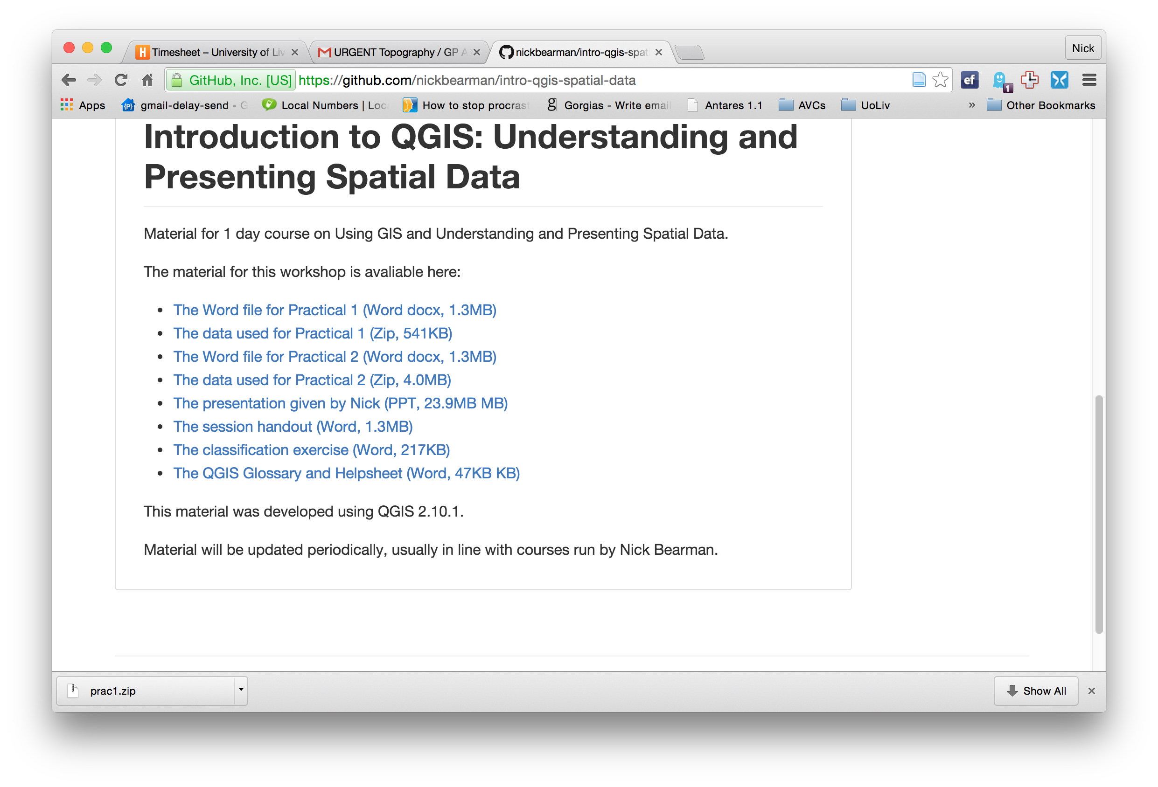

Slide 67
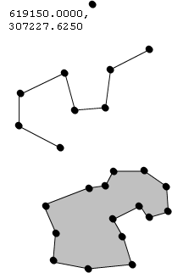
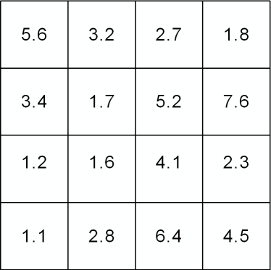

Vector and Raster data
Points, Lines & Polygons
Grid Based
Road networks
Rivers and lakes
Street addresses or postcodes
Administrative areas/boundaries
Elevation
Temperature
Land cover
Population density
Light reflectance (in the form of satellite or aerial imagery)
Notes:
-Raster data is constructed by surveying or sampling at regular intervals on a grid layout.
e.g. soil sample every 500m, or interpolated (estimated) from contours.
-Usually assigned a colour in GIS. Includes images, aerial photos.
-You can convert data between the different formats quite easily in the software for different applications

Slide 68
Shapefile Structure
Notes:
.shp, .dbf, .prj
.qpj, .shx

Slide 69
Tiger Conservation Map
By the end of this practical you will be able to:
Design and produce a publication quality map
Export the map as an image file
Understand how to include legends and scale bars.

Slide 71
Map Design
What makes a good map?

Slide 72
Map Design
Clear
Title (caption), legend, scale bar, N arrow
Data source
Copyright / acknowledgements

Slide 74
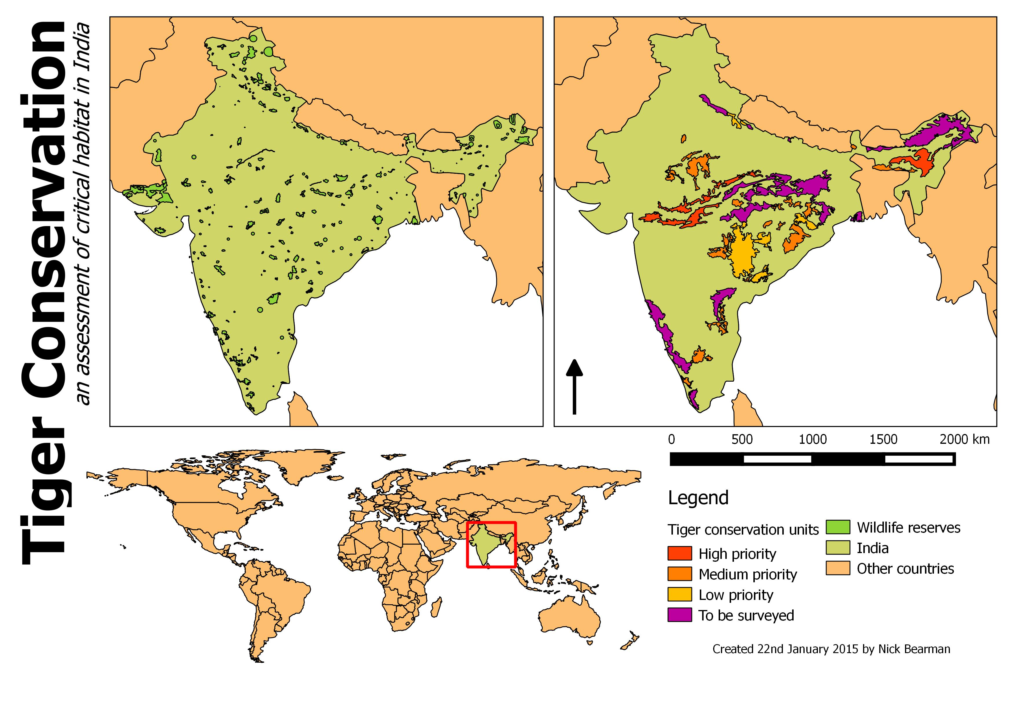

Slide 75
Tea & Coffee

Slide 76
Outline of the day
10:15am – 10:30am – What is GIS?
10:30am - 11:15am – Prac. 1 Intro to QGIS
11:15am – 11:45am – Classification
11:45am - 12:30pm – Prac. 1 Intro to QGIS
12:30pm - 1:30pm – Lunch
1:30pm - 1:45pm – Recap and Map Design
1:45pm - 3:00pm – Practical 2 Tiger Map
3:00pm - 3:15pm – Coffee
3:15pm - 4pm/4:30pm – Practical 2 BYOD
Notes:
Practical 2 – Bring Your Own Data

Slide 77
Outline of the day
9:45am - 10:15am – What is GIS?
10:15am - 11:00am – Prac. 1 Intro to QGIS
11:00am - 11:30am – Classification
11:45am - 12:30pm – Prac. 1 Intro to QGIS
12:30pm - 1:30pm – Lunch
1:30pm - 1:45pm – Recap and Map Design
1:45pm - 3:00pm – Practical 2 Tiger Map
3:00pm - 3:15pm – Coffee
3:15pm - 4pm/4:30pm – Practical 2 BYOD
Notes:
Practical 2 – Bring Your Own Data

Slide 78
Using your own data
Get it in to QGIS
Join it
Look at the attribute data and create new variables
Map it
Or use the Age Structure North West Data mentioned in Practical 2
I will come around on a 1-to-1 basis

Slide 80


Common Problems in Mapping
Data availability
Google, other work
Losing work
Saving, backups, testing backups
Specific feature not working
Restart and try again
Google, Stack Exchange (http://gis.stackexchange.com/)
How do I do x in y?
Google, colleagues

Slide 81
Next Steps
QGIS Plugins
Other QGIS Courses
http://docs.qgis.org/2.2/en/docs/training_manual/
Other GIS:
ArcGIS & R
Courses on analysis:
R & Spatial Analysis
Confident Spatial Analysis
An Introduction to Spatial Microsimulation Using R (Leeds)

Slide 82
Feedback
Feedback is really important for me
Feedback form
Or email / phone / in person

